Slide 1
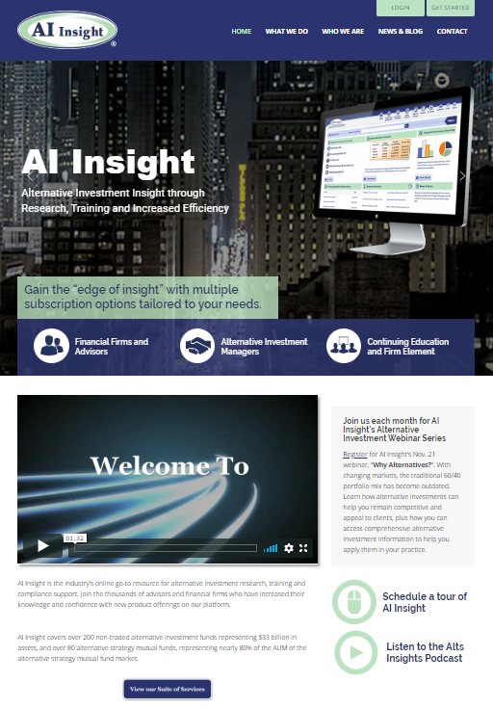
Join us for our upcoming webinars and podcasts:
2020 Webinars
> We’ll announce our January webinar soon.
> Visit the aiinsight.com homepage to register.
Podcast: Alts Insights
> Hear about latest trends AI Insight is seeing in the alternative investment universe.
> Subscribe to us on Podbean or Spotify. Also available on aiinsight.com and our social media accounts.
Notes:
This is our last webinar of the year, so we’ll be announcing our 2020 webinar schedule soon. This will include ongoing performance updates and market insights on private placements, alternative mutual funds, non-traded REITs, interval funds and BDCs. Topics will also include those relevant to current events that impact the alternative investment marketplace.
We’ll publish the 2020 schedule shortly along with links to register. Watch your email for this or you can visit aiinsight.com to register for our webinars.
We also have a podcast called Alts Insights, which covers the latest alternative investment trends we’re seeing. You can find it on our website or social media accounts. You can also subscribe to the podcast on Podbean or Spotify.
[Mike’s bio, Lou’s bio]

Slide 2
Why Alternatives?
AI Insight 2019 Alternative Investment Webinar Series
Join AI Insight throughout the year as we speak with you about relevant topics and trends in the alternative investment industry.
Plus, learn how to better navigate our platform to help you research and efficiently implement alternative investments in your practice.

Slide 3
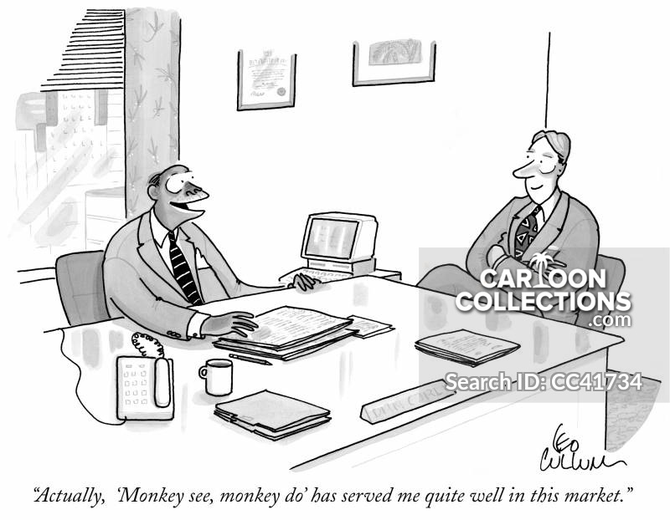
Environment…
Low and slow
Negative yields
Low volatility, until its not
Growth over value
Lately…
Trade wars
Yield curve inversion
Monetary policy uncertainty
Repo market?
Fiscal budget?
Impeachment?

Slide 4
Why Alternatives?
Why?
Portfolio enhancement
Uncertainty reduction (hedging)
Objective/outcome investing
Managing behavioral biases
Why Not?
Difficult to understand
Resources?
Costly to not own beta
Liquidity and fees
Bottom Line >> Alternatives encompasses a wide array of structures and strategies. With proper education and due diligence, they can be an effective tool in providing portfolio solutions.

Slide 5
Mutual Fund
Closed-End Fund
Hedge Fund/Private Fund
Non-Listed Securities
Private Placement
Holdings?
Liquidity?
Horizon?
Fees?

Slide 6
 | Mutual Fund | Hedge Fund/Private Fund
Offering | Public | Private
Structure | Open-End Registered Investment Company (RIC) | Limited Partnership
Manager | SEC Registered Investment Advisor | General Partner; often registered as a Limited Liability Company
Minimum Investment | Low | High
Fees | Annual Expense Ratio | Asset Management Fee + Performance Incentive Fee
Liquidity | Daily | Discretion
Illiquid Investments | 15% Max | No Limit
Leverage | 33.3% Max | No Limit
Tax Form | 1099 | K-1
Suitability Requirement | None | Accredited Investor or Qualified Purchaser

Slide 7
Registered Investment Company (RIC)
Registered per the Investment Company Act of 1940
Annual Expense Ratio
Closed-End Fund
Initial capital raise period – IPO
Listed on an exchange for public trading
Interval Fund
Fund company offers shares on a continuous basis
Limited liquidity; between 5-25% of shares per year
Managed by a Registered Investment Advisor
Finite amount of shares available to the market
Not listed on an exchange for trading; exit event unknown

Slide 8
Private Placements
Reg D Type | Offering Limit/Year | Non-Accredited Investors | Accredited Investors | Financial Stmt. Audit Required
504 | $1 mm | No Limit | No Limit | No
505 | $5 mm | Up to 35 | No Limit | Yes
506 (b and c) | No Ceiling | Up to 35 | No Limit | Yes
Source: Financial Poise
Common Offerings
1031 Exchange Energy Opportunity Zones | Preferred Securities Private Equity/Debt Other Real Estate

Slide 9
Real Estate Investment Trusts (REITs)
Private | Non-Listed | Listed
Not SEC Registered | SEC Registered | SEC Registered
Non-Traded | Non-Traded | Traded
Life Cycle | Perpetual
Finite Offering Sector Specific No Liquidity Growth Focus | Continuous Offering Diversified by Sector Limited Liquidity Income Focus

Slide 10
Liquidity
Open-End Funds Closed-End Funds Listed REITs | Interval Funds | Perpetual NT REIT NT Closed-End Fund | Lifecycle NT REIT Private Placement Private Funds/REITs
Market Timing
Open-End Funds Closed-End Funds Listed REITs | Interval Funds Perpetual NT REIT NT Closed-End Fund Private Funds/REITs* | Lifecycle NT REIT Private Placement

Slide 11
Non-Accredited | Accredited
Open-End Funds (Mutual Funds, ETFs) Closed-End Funds (incl. Non-Traded) Interval Funds Non-Traded REITs Listed REITs Private Placements* | Hedge Funds Private Equity Private Placements Private REITs

Slide 12
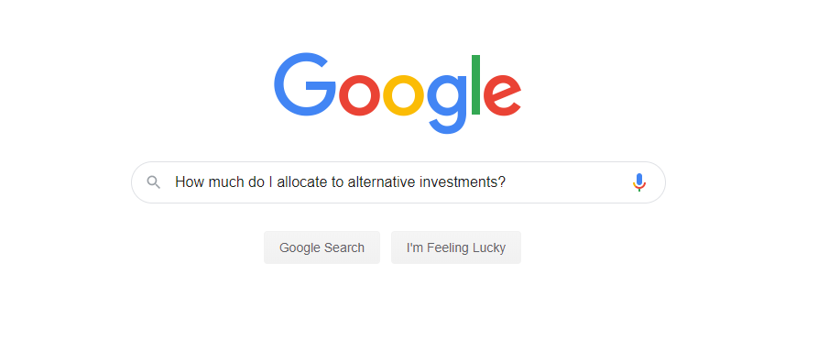
↖

Slide 13
Source: Blackstone. “Alternatives in the Mainstream: A Potential Growth Opportunity for Advisors.”
Source: Willis Towers Watson. “Global Pension Assets Study 2019.”

Slide 14
Asset Allocations for U.S. College and University Endowments and Affiliated Foundations, Fiscal Year 2018 (6/30/2018)
 | Domestic Equity % | Fixed Income % | Non-US Equity % | Alternative Strategies % | Cash/Cash Equiv. %
Over $1 Billion | 13 | 7 | 19 | 58 | 3
$501 Million to $1 Billion | 22 | 10 | 22 | 41 | 5
$251 Million to $500 Million | 24 | 12 | 22 | 38 | 4
$101 Million to $250 Million | 31 | 15 | 22 | 27 | 5
$51 Million to $100 Million | 34 | 19 | 22 | 22 | 3
$25 Million to $50 Million | 39 | 22 | 18 | 16 | 5
Under $25 Million | 45 | 24 | 15 | 11 | 5
Source: 2018 NACUBO-TIAA Study of Endowments

Slide 15
 | Convergent Strategies | Divergent Strategies
Traditional Investments | Long Only Equity | Long Only Momentum
 | Long Only Fixed Income
Alternative Investments | Long Short Equity Event Driven | Managed Futures Event Driven
 | Long Short Fixed Income Relative Value Fixed Income Global Macro | Global Macro
Source: Natixis Investment Managers. “Divergent Strategies: a new way to think about portfolio construction.”

Slide 16
Client Primary Goals | Primary Role of Alternative Investment | New Alternative Asset Category | Client Primary Benchmark
Capital Preservation | Inflation Protection | Real Assets: Commodities ex Precious Metals Precious Metals / Gold Master Limited Partnerships Global REITs | Real Return: CPI Plus
Income | Real Return Enhancement / Preservation | Total Return Assets: Equity Market Neutral Relative Value | LIBOR Plus; 3-Month US T-Bill Plus 300 bps
Balanced Growth | Volatility Management | Equity Hedge Assets: Global Macro Managed Futures Hedge Fund of Fund i.e. Multistrategy Alternatives | Total Return; 60% Stocks / 40% Bonds
Market Growth | Equity Diversification | Equity Return Assets: Equity Long Short Event Driven | 500 Plus 200-400 bps
Opportunistic Growth | Growth Amplification | Opportunistic Assets: Private Equity Private Direct Real Estate Distressed Debt/Lending Venture Capital | Mandate Specific
Source: Morgan Stanley Wealth Management. “An Outcomes-Oriented Approach to Alternatives.”

Slide 17
Category | Description
Core Alternative | Portfolio Diversification
Equity Alternative | Equity Diversification
Fixed Income Alternative | Fixed Income Diversification
Alternative Beta | Return Diversification

Slide 18
Consideration | Understanding | What to Watch For
Market Conditional Performance | Performance expectations in various market environments. | Tactical managers; change in management; persistency in process.
Investment Design | How does the strategy or asset class earn returns i.e. value proposition. | Tactical managers; change in management; persistency in process.
Downside Exposure | Systematic risk relative to traditional asset classes. | Upside versus downside.
Volatility | Risk profile of the strategy or asset class. | Volatility that is volatile; investment return horizon; loss tolerance.
Liquidity | Liquidity profile of the strategy or asset class. | Investment horizon; provisions; manager discretion; risk profile relative to liquidity offering.
Benchmarking | Relative/absolute performance expectations over a full market cycle. | Cash vs. market benchmarks; risk-adjusted return; time horizon.

Slide 19
Benchmarking
Benchmark | Disadvantages
Cash | Sets a low bar for performance.
Cash + “x%” | Unrealistic – benchmark is not investable.
60/40 Portfolio | Dominated by equity risk.
Peer Average | Lack of homogeneity across strategies.
Better Approach?
Analyze performance from a portfolio perspective. In other words, is the investment additive to my portfolio.

Slide 20
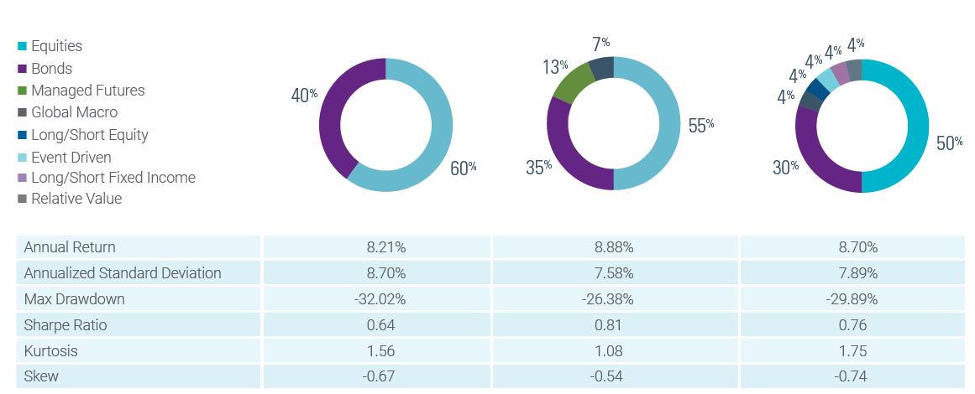
Source: Natixis Investment Managers. “Divergent Strategies: a new way to think about portfolio construction.”

Slide 21
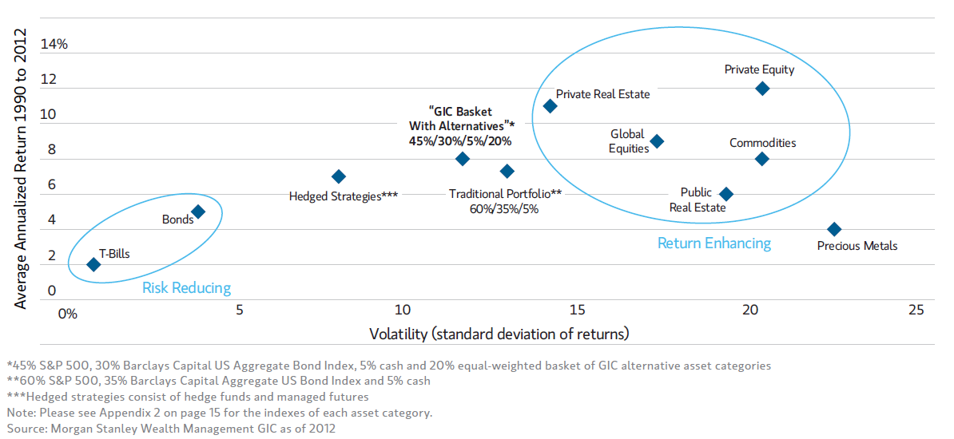
Source: Morgan Stanley Wealth Management. “An Outcomes-Oriented Approach to Alternatives.”

Slide 22

Lou Johnson, CFA
Alternative Investment Analyst
ljohnson@aiinsight.com
(303) 895-4316
Thank You!

